Slide 1
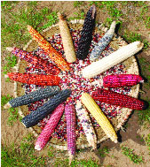
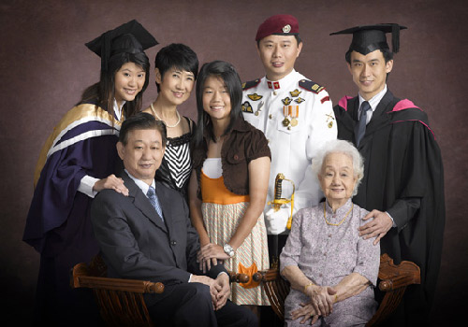
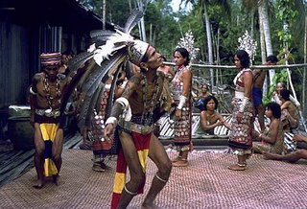
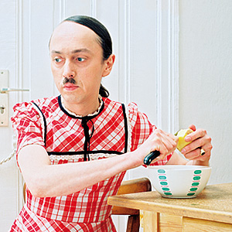
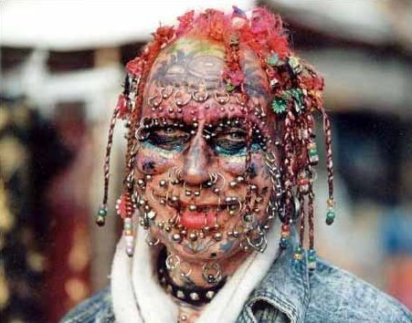
REVIEW

Slide 2
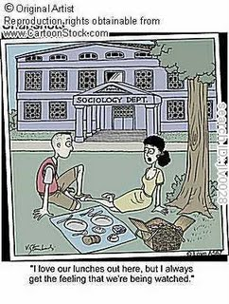
TOPICS
Culture & Socialisation
Families
Race & Ethnicity
Gender & Sexuality
Deviance & Crime

Slide 3
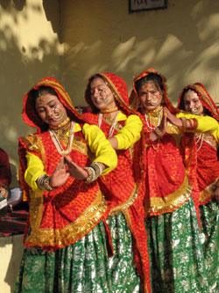
CULTURE & SOCIALISATION
Defining ‘Culture’ (forms)
Elements of Culture
Culture and Socialisation
Ethnocentrism/ Cultural Relativism
Comparing Cultures – Mainstream; Subculture; Counterculture
Analysing Culture – Theories
Culture & Globalisation - Glocalisation
Notes:
Question those that is taken for granted. Question what is the elements and component of culture. What is the content and form of culture. Analysing culture across different time, space and context.

Slide 4
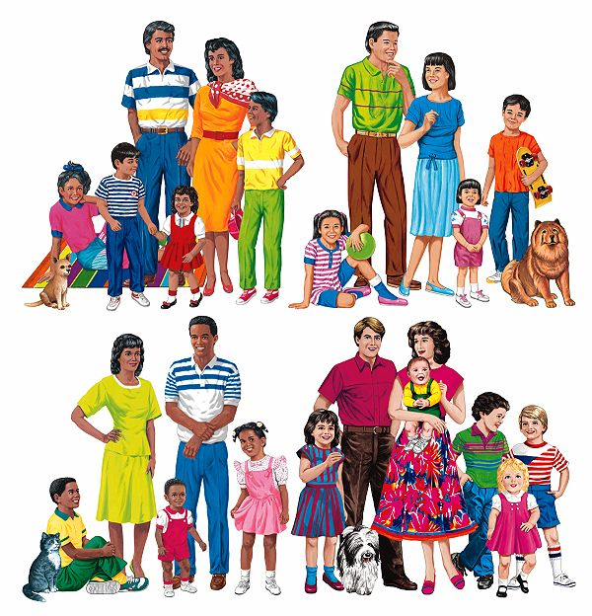
FAMILIES
‘Families’ instead of ‘Family’ (Euro-Western & Asian examples; generalities and diversity; familial practices; form/function)
Theorising Families
Diverse Family forms
Family and Social Change/ Policy
Notes:
There is no universal types of family. Difference cross cultural context. Women as a possession of man. Form versus the function of the family unit. Families are starting to change and thus there is social change, and how far or how close is the government catching up with the change in the family forms. Martial rape is the closing form to understand what is gender relations.

Slide 5
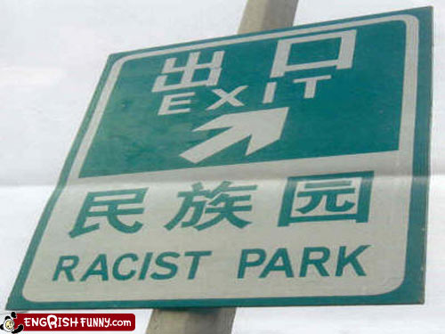
RACE & ETHNICITY
Problematising ‘Race’ and ‘Ethnicity’
Minority group, Stereotypes
Prejudice & Discrimination
Racism
Racial/Ethnic Violence
Theories
‘Race’ in Singapore
Notes:
Race is based on presumed biological characteristics. Ethnicity is based on a shared culture forms.

Slide 6
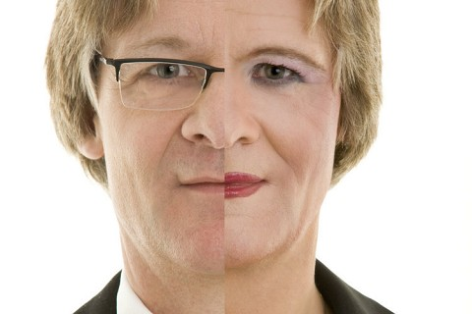
GENDER & SEXUALITY
Explicating key terms: Sex, Gender, Sexuality
Learning and ‘Doing’ Gender
Theories
Gender Inequality
Intersections
Levels of Analysis
Notes:
Sex is biological, which itself is ambiguous, and what about trans-sex or those both with both sex. Intersections between ethnicity and gender; receiving ends of double or triple discrimination.

Slide 7
DEVIANCE & CRIME
Sociological definition of Deviance
Deviance, Power and Social Control
Comparing Deviance and Crime
Theorising Deviance
Motivational Theories
Constraint Theories
Moral Panic
Notes:
If something is out of place, then we regard it as deviant or out of path. Straying away the normal path kicks in rules. Social sanctions. Informal or formal sanctions. Theories are ways to explain what is going on.

Slide 8
DEFINING KEY TERMS
Moving away from commonsense knowledge or ideas about social life and society
Sociological definitions
Time, place, context
Social actors, interaction, power relations

Slide 9
THEORIES
To explain social phenomena
A mode of interpretation and explanation
Different theories touch on different aspects
Evaluating theories and their strengths and weaknesses
Relevance and suitability of theories to explain given phenomenon

Slide 10
OTHER SUBSTANTIVE/BROADER ISSUES
Glocalisation
Family and the State
Race, Ethnicity and Violence
Degendering Society
Moral Panic
Power relations
Social actors
Moral standards
Inequalities
Processes of Social Change

